Slide 1
CORNELL CONSULTING CLUB
EST. 2001
Group Case
Spring 2023

Slide 2
OVERVIEW
Sarah is a seasoned business woman and has worked at various coffee houses throughout her career. She has a lot of experience and success with marketing and launching new businesses.
Sarah is interested in creating a new café-chain of her own and currently has millions of dollars in interest from investors. She has a few requirements for her project:
The first three cafes must be launched in the U.S.
There must be a café feel to her openings (i.e. they cannot be fully self-service or to-go, there must be seating/wifi etc.)
CC Group Case| Spring 2023
2

Slide 3
QUESTIONS
How should Sarah approach deciding where to place her cafes?
Where should she position her first three cafes? (Refer to included graph)
Sarah has determined that the cost to develop each café is $5M up-front and an additional $1M in recurring cost. You can assume that one store is opened each year and each store captures .1% of the total market ($7B) each year. Could Sarah break even at the end of 3 years (i.e. beginning of year 4)?
Investors are worried that the cafes won’t achieve consistent revenues each year. What are 2 strategies you would recommend Sarah implement to ensure consistent profits?
What is one unique factor Sarah can employ that is different from Starbucks and its cafes?
CC Group Case| Spring 2023
3

Slide 4
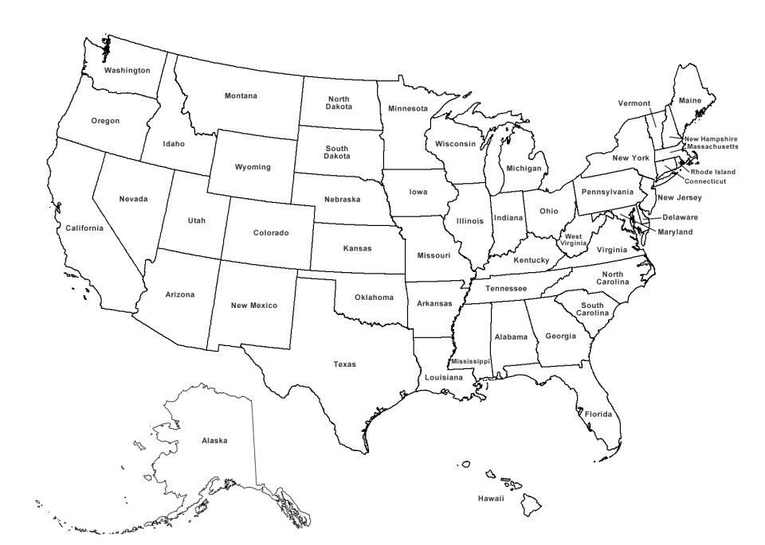
INFOGRAPHIC
Text
Text
Text
Text
Text
Text
Text
Text
Text
Key:
Size of circle corresponds with size of market in those areas
CC Group Case| Spring 2023
3

Slide 5
ANSWERS
How should Sarah approach deciding where to place her cafes?
Good candidates will mention understanding supply (competition), demand (customers), ease of entry in the particular cities, proximity to suppliers
Where should she position her first three cafes? (Refer to included graph)
***KEY TO THIS QUESTION IS THEIR RATIONALE MORE THAN THE ACTUAL ANSWER***
Good candidates will recognize that a higher concentration of cafes means higher demand but also higher competition. They could suggest diversifying and opening two cafes in medium-sized circle regions, and one in a big circle region
Another option: open all three cafes in medium-sized markets to minimize risk of being “drowned out” by bigger brands, but also to capitalize on existing demand
Another option: open all three cafes in small-sized markets and create demand, considering Sarah’s experience and large financial backing, she can do a big marketing push and grow quickly
Another option: open all three in a big market and compete directly with big brands same reasoning as small-sized market option
CC Group Case| Spring 2023
3

Slide 6
ANSWERS
Sarah has determined that the cost to develop each café is $5M up-front and an additional $1M in variable costs. You can assume that one store is opened each year and each store captures .1% of the total market ($7B) each year. Could Maggie break even at the end of 3 years (i.e. beginning of year 4)?
Profit = $7M * 6 - ($6M + $7M + $8M) = $42M - $21M = $21M profit
Investors are worried that the cafes won’t achieve consistent revenues each year. What are 2 strategies you would recommend Maggie implement to ensure consistent profits?
Look for creativity & feasibility here. Sample answers include loyalty programs, temporary pre-launch pop-up shops to garner interest in the areas, host social/ community events, allow space to be rented for external events
What is one unique factor Sarah can employ that is different from Starbucks and its cafes?
Look for creativity & feasibility here. Sample answer: Be fully vegan, pet friendly café, host social events for the community etc. live music (good answers here could overlap with previous answers)
Y1 | Y2 | Y3
($5M + $1M) | ($5M +$1M + $1M) | ($5M +$1M + $1M+ $1M)
$7M | $7M | $7M
 | $7M | $7M
 |  | $7M
CC Group Case| Spring 2023
3

